Slide 1
Physics 1 – Oct 22, 2019
Do Now – Mechanics Intuition Assessment (MIA) standardized test (30 min)
As a test of intuition, go with your gut, or your first choice. Don’t try to over think.
Today’s Objective: Second Law Problem Solving (frictionless)
Get out 2nd Law p1 homework for check

Slide 2
Agenda, Assignment
IB 2.2 Forces
Second Law Problems (frictionless)
Agenda
Homework Review on White Boards (each table prepares a board with solutions to both 1 and 2)
More Sample problems
Assignment:
Second Law Problems Worksheet

Slide 3
Typical Second Law Problem Solving
1) Draw the system. Label with masses and Forces and any other data.
2) Choose the body of interest (to be treated as a point mass) and a frame of reference.
3) Draw the Free Body Diagram, including all forces acting on the body of interest. Include the direction for each.
4) Resolve all forces at an angle into their x and y components.
5) Write the expression for the net force in each dimension (F_{net,x} = Right – left, F_{nety} = Up – down)
6) Write the second law equation for each dimension F_{net,x} = ma_{x} F_{nety} = ma_{y}
7) (Opt first or last step) Connect to kinematics through acceleration.

Slide 4
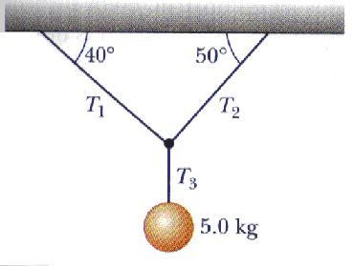
Sample 2nd Law Problem
Determine the three tensions.

Slide 5
Sample 2nd Law Problem
Four penguins are being playfully pulled along very slippery (frictionless ice) by a curator. The masses of three of the penguins and two of the tensions are known. m₁ = 12 kg, m₃ = 15 kg, m₄ = 20 kg, T₂ = 111 N and T₄ = 222 N. Determine the mass of the fourth penguin m₂, the acceleration of the penguins, a, and the two missing tensions. T₁ and T₃.

Slide 6
Exit Slip - Assignment
How do you write the second law equation in the x dimension? In the y dimension?
What’s Due? (Pending assignments to complete.)
Complete the 2nd law worksheet
What’s Next? (How to prepare for the next day)
Read p57-75

